Slide 1

Note: The data and information in this document is reflective of a hypothetical situation and client. This document is to be used for KPMG Virtual Internship purposes only.
Sprocket Central Pty Ltd
Data analytics approach
[KPMG] - [Siddhartha Ireddy]

Slide 2
Note: The data and information in this document is reflective of a hypothetical situation and client. This document is to be used for KPMG Virtual Internship purposes only.
Agenda
Introduction
Data Exploration
Model Development
Interpretation

Slide 3
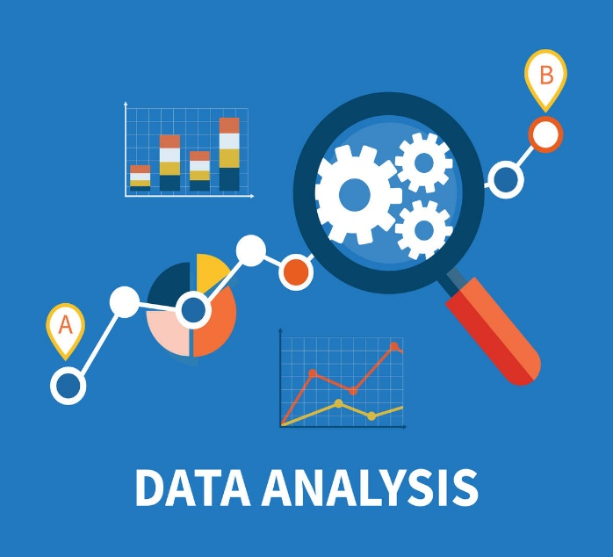
Note: The data and information in this document is reflective of a hypothetical situation and client. This document is to be used for KPMG Virtual Internship purposes only.
Introduction
Data analysis is defined as a process of cleaning, transforming, and modeling data to discover useful information for business decision-making. The purpose of Data Analysis is to extract useful information from data and taking the decision based upon the data analysis.
It involves:
Data Gathering
Data Collection
Data Cleaning
Data Analysis
Data Interpretation
Data Visualization

Slide 4
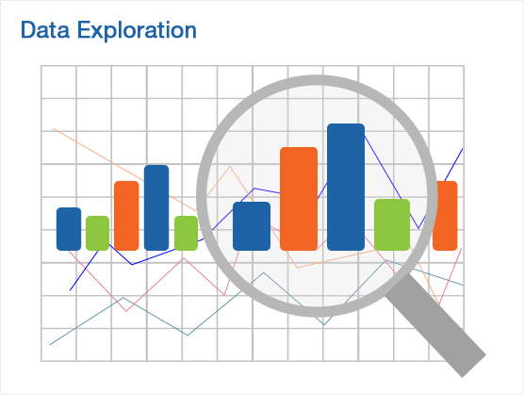
Note: The data and information in this document is reflective of a hypothetical situation and client. This document is to be used for KPMG Virtual Internship purposes only.
Data Exploration
Data Exploration is using visualization and statistical techniques to describe data characterizations, such as size, quantity, and accuracy, in order to better understand the nature of the data. Exploratory Data Analysis helps for this purpose.
To identify the correlation between two continuous variables correlation can be used.
To identify the relation between two categorical variables the two-way table method, the chi-square test are effective.
Other techniques like ANOVA, finding Distributions can also be implemented.

Slide 5
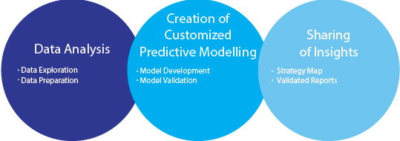
Note: The data and information in this document is reflective of a hypothetical situation and client. This document is to be used for KPMG Virtual Internship purposes only.
Model Development
Model Development is a comprehensive process of formulating a Model/System that helps to achieve the desired goal.
Example: Predictive Modelling
In Data Analysis the Model development involves the process like Business understanding, Data Cleaning, Data preparation, Data Modelling, Data Evaluation and Deployment

Slide 6
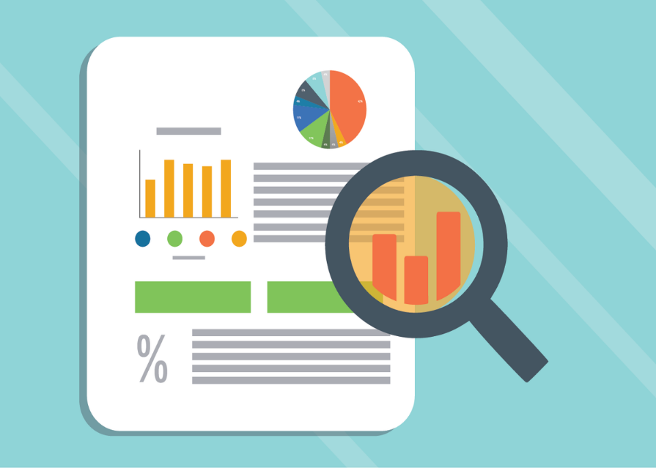
Note: The data and information in this document is reflective of a hypothetical situation and client. This document is to be used for KPMG Virtual Internship purposes only.
Interpretation
Data interpretation is the process of reviewing data through some predefined processes which will help assign some meaning to the data and arrive at a relevant conclusion. It involves taking the result of data analysis, making inferences on the relations studied, and using them to conclude.
Interpretation of Data involves Data Analysis, getting insights and drawing conclusions from the analysis that help for solving the business problem.

Slide 7
Note: The data and information in this document is reflective of a hypothetical situation and client. This document is to be used for KPMG Virtual Internship purposes only.
Thankyou

